Slide 1
Digital Portfolio
STUDENT NAME: Pranav.N
REGISTER NO AND NMID: asbruaz2426j1540&2426j1540
DEPARTMENT: B.SC.Information Technology
COLLEGE:KPR College Of Arts Science And Reasearch

Slide 2

PROBLEM STATEMENT
In today’s competitive job market, traditional resumes and portfolios often fail to capture the attention of recruiters, as most of them look very similar and provide limited engagement.
Job seekers, especially in creative and technical fields, need innovative ways to showcase their skills beyond plain text and static designs. At the same time, employers are looking for candidates who can stand out, demonstrate creativity, and present their abilities in an interactive manner.
A gamified portfolio website addresses this challenge by combining professional achievements with engaging game-like elements (e.g., levels, badges, progress bars, interactive challenges).
This not only makes the portfolio more appealing and memorable but also allows recruiters to explore a candidate’s skills in a fun, interactive, and impactful way.

Slide 3
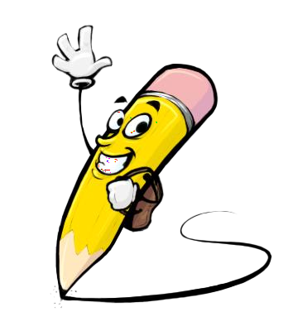
PROJECT OVERVIEW
The Gamified Portfolio Website is an interactive platform designed to showcase an individual’s professional resume, skills, projects, and achievements in a game-like format. Instead of presenting information in a traditional, static manner, the portfolio uses gamification elements such as levels, progress bars, badges, challenges, and achievements to make the user experience engaging and memorable.
This project aims to help job seekers, students, and professionals stand out in a competitive market by combining personal branding with interactive storytelling. The website not only displays academic and career information but also reflects creativity, problem-solving ability, and technical expertise in web development.
By turning a simple resume into an interactive journey, the Gamified Portfolio increases user engagement, leaves a lasting impression on recruiters, and demonstrates the individual’s ability to think outside the box.

Slide 4
FEATURES AND FUNCTIONALITY
Interactive Start Screen – Portfolio opens like a game with a “Start Journey” button.
Profile as Character Card – About section shown as a game avatar with level, XP, and skills.
Gamified Skills Display – Skills shown as progress bars, badges, or power-ups.
Projects as Quests – Each project displayed as a mission/quest with status (Completed / In Progress).
Achievements & Badges – Certifications, awards, and milestones displayed as collectible rewards.
Career Timeline as Levels – Education and experience shown as different levels/stages cleared.
Interactive Animations – Hover effects, progress unlocks, and “level-up” style transitions.
Leaderboard / Stats – Optional section showing GitHub commits, hackathon scores, or coding streaks.
Contact Section (Final Stage) – Recruiters can connect via form, email, or social links styled as “Unlock Next Stage.”

Slide 5
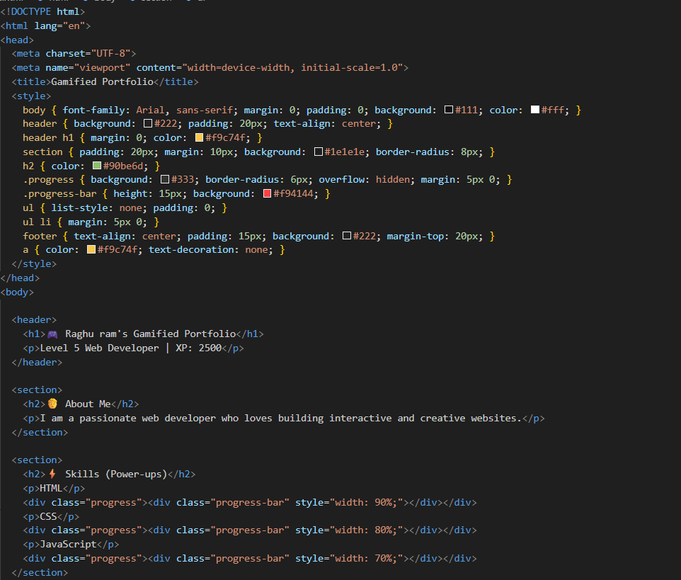
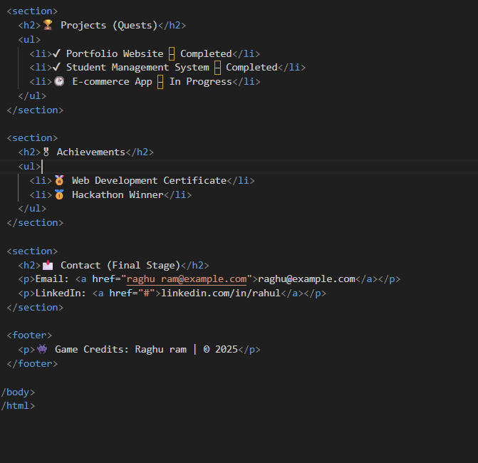
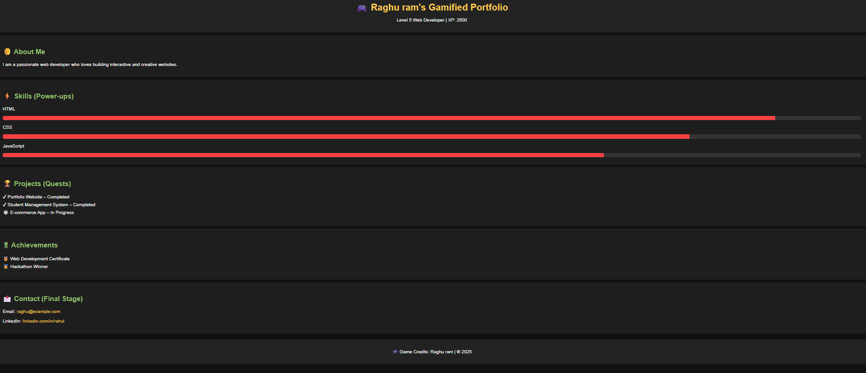
RESULTS AND SCREENSHOTS
3/21/2024 Annual Review

Slide 6
CONCLUSION
The Gamified Portfolio transforms a traditional resume into an engaging, interactive experience. By using game-like elements such as levels, quests, achievements, and progress tracking, it not only highlights skills and projects but also captures the attention of recruiters and employers in a creative way. This approach makes personal branding more memorable, enhances user engagement, and provides a modern way to showcase professional growth. Ultimately, a gamified portfolio helps individuals stand out in today’s competitive job market.

Slide 7
